Slide 1
Running, improving and maintaining a site in the real world
Shravan Kumar Kasagoni
Microsoft MVP – ASP.NET/IIS
Email: shravan.kasagoni@outlook.com
Twitter: @techieshravan

Slide 2
Agenda
Scenario: Scale
Scenario: Adapt to Change
Scenario: Environments

Slide 3
Let’s get Real

Slide 4
Scenario: Scale

Slide 5
Scenario description
Your site load varies over time.
You need to adapt.
Smoothly.

Slide 6
Load profiles
BATCH
PREDICTABLE
No
load
Load
Load
INCREASING
UNPREDICTABLE
Load
Load

Slide 7
Step 1: Preserve server bandwidth
PROBLEM:
Your servers are wasting bandwidth serving static files.

Slide 8
Step 1: Preserve server bandwidth
SOLUTION:
Serve static files from blob storage.
This is a step towards to delivering content from a content delivery network (CDN).

Slide 9
Step 2: Caching
PROBLEM:
Your servers have finite resources.
You don’t want to repeat work you don’t have to.

Slide 10
Step 2: Caching
SOLUTION:
Store ASP.NET page output cache in Windows Azure Caching Service.

Slide 11
Step 3: Manual scale
PROBLEM:
You need more server resources.

Slide 12
Step 2: Manual Scale
SOLUTION:
Add more servers (horizontal scaling).
Use more powerful servers (vertical scaling).

Slide 13
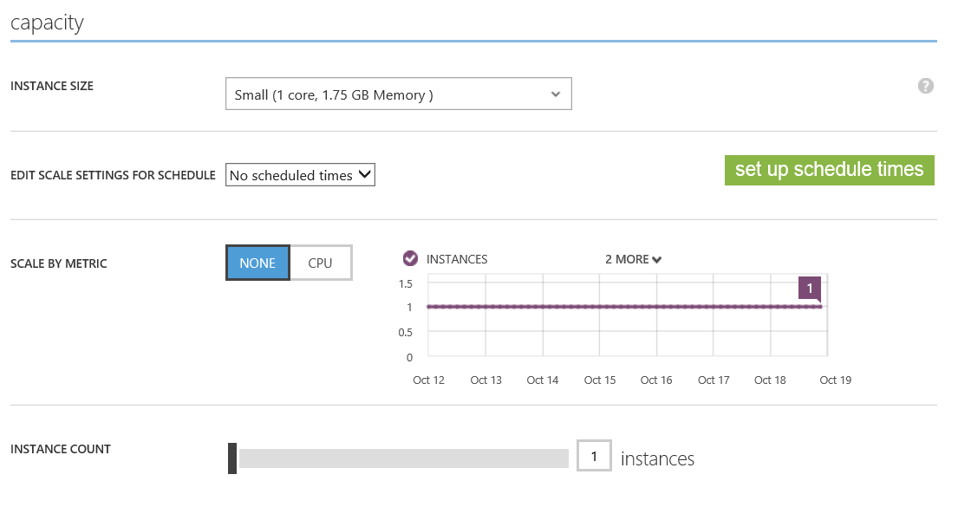

Slide 14
Step 3: Auto-scale
PROBLEM:
Manual scaling reaction time means outages.
Manual scaling is busy work.

Slide 15
Step 2: Auto-scale
SOLUTION:
Use auto-scale.

Slide 17
Demo
Scenario: Scale

Slide 18
Scenario: Change

Slide 19
Scenario description
Your site isn’t done when you deploy to production.
You need to add new features.
Change adds risk.

Slide 20
Step 1: Manage database schema
PROBLEM:
Your database and application code need to stay in sync.

Slide 21
Step 1: Manage database schema
SOLUTION:
Use Entity Framework Data Migrations.

Slide 22
Demo
Scenario: Data migrations

Slide 23
Step 2: Manage deployments
PROBLEM:
People sometimes make misteaks.

Slide 24
Step 2: Manage deployments
SOLUTION:
Use deployment rollback.

Slide 25
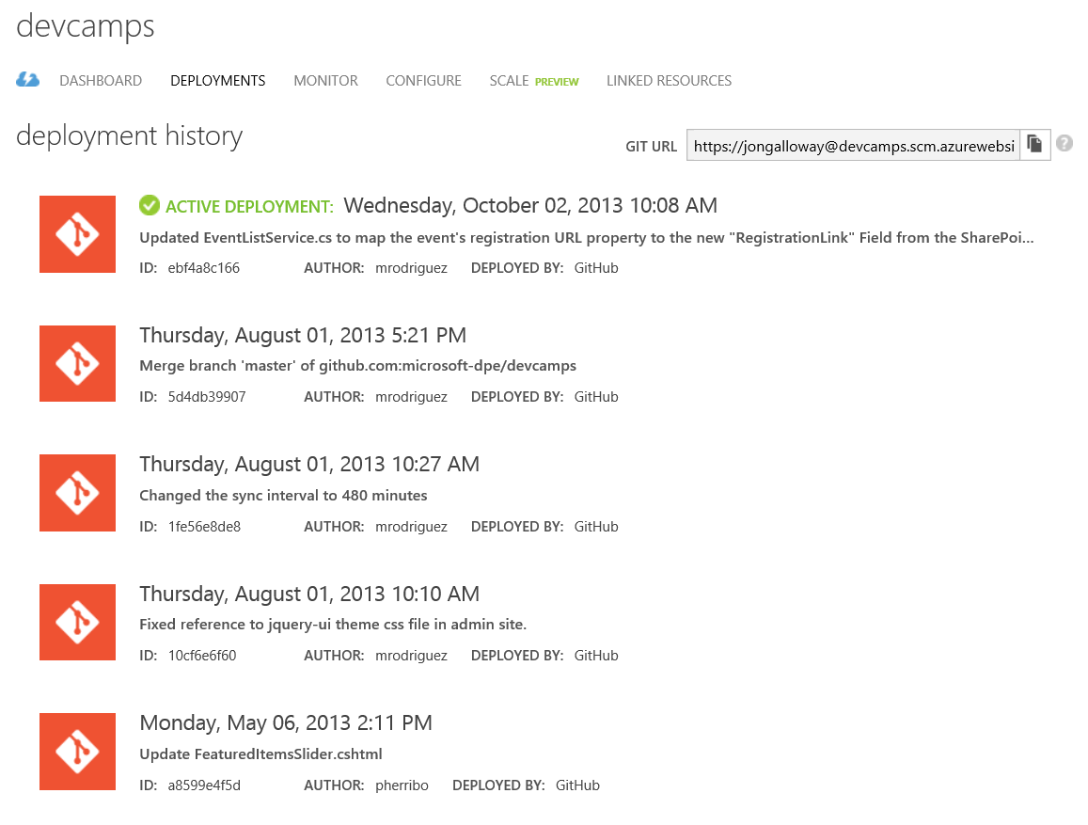

Slide 26
Demo
Scenario: Deployment rollback

Slide 27
Step 3: Leverage services
PROBLEM:
Large changes often require you to add new features quickly.

Slide 28
Step 3: Leverage services
SOLUTION:
Take advantage of available Windows Azure services.

Slide 29
Demo
Scenario: Windows Azure Active Directory

Slide 30
Scenario: Multiple Environments

Slide 31
Scenario description
Running a real site requires multiple internal environments.
Global availability requires multiple worldwide deployments.

Slide 32
Step 1: Dev / Test environments
PROBLEM:
Setting up development web server environments is time consuming.
You need to see your code running somewhere other than deployment before deploying.

Slide 33
Step 1: Dev / Test environments
SOLUTION:
Environment consistency via deployment setup in Windows Azure Web Sites or VM images.
Cost savings by paying only for what you need.

Slide 34
33%
25%
NO
DISCOUNT RESERVED WEB SITES CLOUD SERVICES, HDINSIGHT
CREDIT CARD REQUIRED
DISCOUNT VIRTUAL MACHINES
$150
$100
$50
MONTHLY CREDIT
VISUAL STUDIO ULTIMATE WITH MSDN
MONTHLY CREDIT
VISUAL STUDIO PREMIUM
WITH MSDN
MONTHLY CREDIT
VISUAL STUDIO PROFESSIONAL WITH MSDN

Slide 35
Step 2: Global Reach
PROBLEM:
It’s hard to deploy a consistent environment in multiple datacenters.

Slide 36
Step 2: Global Reach
SOLUTION:
Use automated deployment workflow to ensure consistency in deployment process.

Slide 37
Step 3: Continuous Delivery
PROBLEM:
Bugs and issues in your code get harder to fix the longer it takes to find out about them.
Deployment is a risky, error-prone operation.

Slide 38
Step 3: Continuous Delivery
SOLUTION:
Use continuous integration to automate build, unit & integration testing.
Use automated deployment workflow to ensure consistency in deployment process.

Slide 39
Demo
Scenario: Multiple environment

Slide 40
Thank You

